Slide 1


Python + Research Skills
Economics Club - 3/11/26

Slide 2
What is Python and why does it matter?
Python is a programming language used to analyze and work with data
Widely used in economics, finance, research, and tech
Helps automate tasks like cleaning datasets, running regressions, and creating graphs
Works with libraries like:
NumPy – Numerical computing
Pandas – Data manipulation and analysis
Matplotlib / Seaborn – Data visualization and charting
**These libraries have a corresponding website with guides and tutorials
Increasingly required for research, internships, and data-driven careers
—-------------------------------------Let’s get into it!------------------------------------------

Slide 3
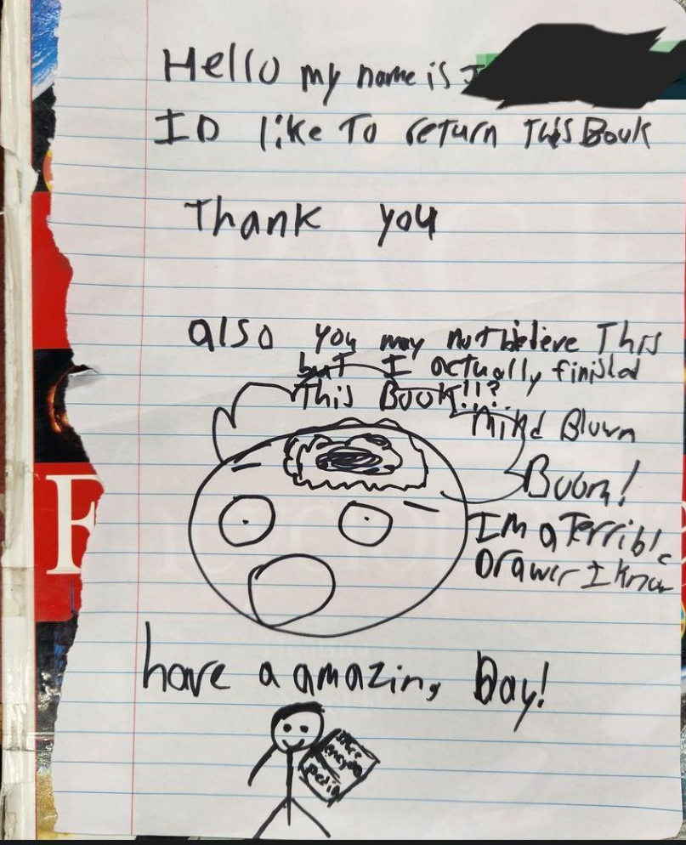
Library Resources
Top 3 Business Databases
Business Source Premier
ABI Inform Global
Business Abstract with Full Text (H.W. Wilson)
Accessing articles: don’t click on “online access,” click on the actual name title
Mr. Terrance Bennett (the G.O.A.T.)
TCNJ Libguides
Interlibrary Loan
NYT loophole
Mercer County Library Card

Slide 4

Jen’s notes
Zoom, Excel, Linkedin Learning all free!
Start networking on linkedin with alumni/people you look up to
Recruitment at large firms starts 1+ year out (start looking at junior year summer internships as a freshman)
Involvement is crucial
Student orgs
Volunteering
Work on campus
Conferences
AEA meetings
Regional meetings
Specialized subject conferences
Study rooms in tutoring center
Competitions
College FED Challenge
J&J Case Competition
Mayo Business Plan
Explore:
Makerspace in AIMM
Observatory
Greenhouse
Office hours
Research with professors
MUSE
Go watch senior thesis presentations at COSA!!! (Tues, April 28th)

Slide 5

Upcoming Events
TODAYYY!
Cosponsorship with Women in Business
Spring Leadership Summit
3–5 PM in the BB Basement
Alissa Hubler (Demand Planner, Church & Dwight)
Victoria Rendine (Manager of GTM Strategy, Ralph Lauren)
Alla Tsypenyuk (Program Manager for Gen AI Creatives, YouTube Ads at Google)
Sandy Papavero (Transformational Business Strategist)
Jacky Mentone (Project Management)
Amanda Terreri (Manager, Customer Logistics at Kenvue).

Slide 6
Upcoming Events
Zoom with 7 Economics Alumni
Wednesday Mar 25, 12-1pm
Senior Economist at International Monetary Fund
Senior Economist at Tax Foundation
Economist at Indeed
Co-Head of North American Power at Hartree Partners
Associate Professor at Saint Anselm College
Assistant Professor at Tennessee Tech
Financial Economist at U.S. Securities and Exchange Commission
Cosponsorship with TCNJ Career Center - The Networking Exchange
Wed, Mar 25, 2 PM-4:30 PM in BB Basement
Connect with Employers and Alumni at the TCNJ Career Center's inaugural Networking Exchange! Learn the art of networking while connecting with industry professionals, practice your elevator pitch, and build your confidence in telling your story

Slide 7
Any Questions?

